Slide 1

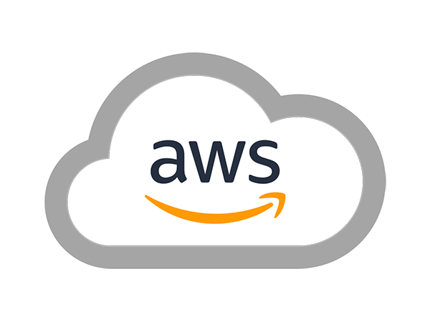
AWS SOLUTIONS ARCHITECT ASSOCIATE
Module 4:
Amazon Virtual Private Cloud

Slide 2

Module Overview
Amazon Virtual Private Cloud (VPC), Components
Amazon Virtual Private Cloud (VPC), Optional Components
Network Diagram

Slide 3

Lesson 01: Amazon Virtual Private Cloud (VPC),
Components

Slide 4
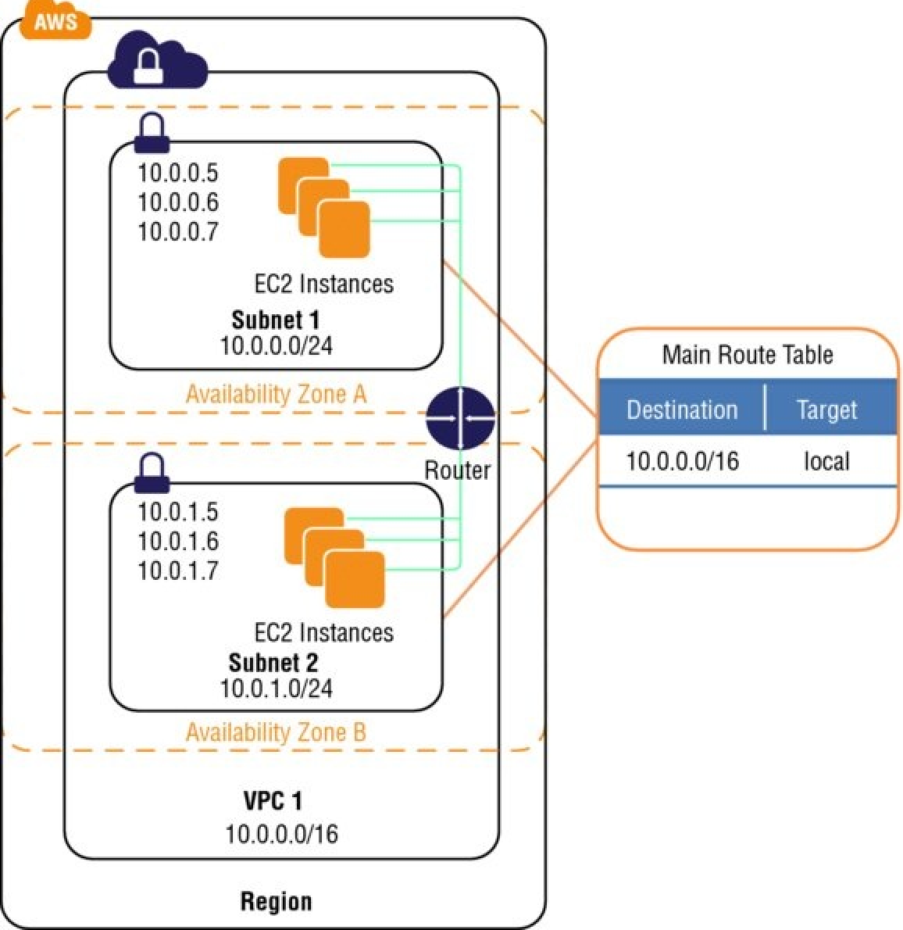
Amazon Virtual Private Cloud (VPC), Components

Slide 5

Amazon Virtual Private Cloud (VPC), Components
Subnets
Route tables
Dynamic Host Configuration Protocol (DHCP) option sets
Security groups
Network Access Control Lists (ACLs)

Slide 6
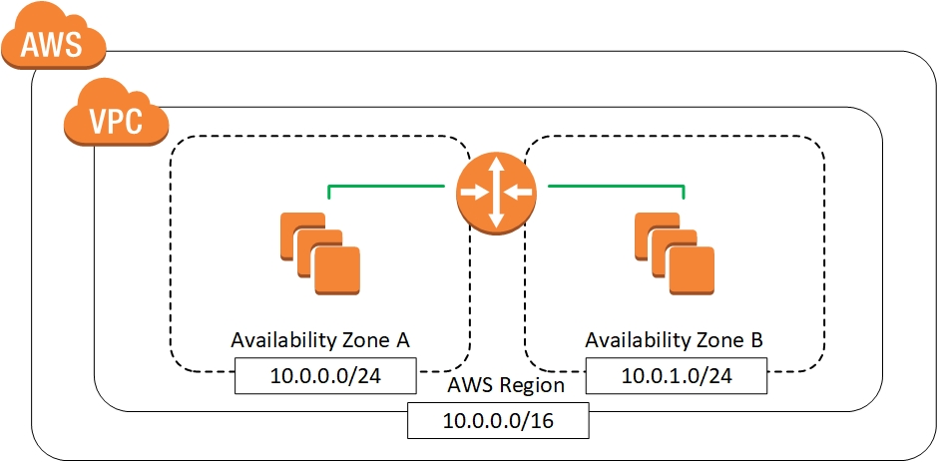
Amazon Virtual Private Cloud (VPC), Components
Subnets

Slide 7

Amazon Virtual Private Cloud (VPC), Components
Route Table

Slide 8
Amazon Virtual Private Cloud (VPC), Components
Dynamic Host Configuration Protocol (DHCP) option sets
  domain-name-servers
  domain-name
  ntp-servers
  netbios-name-servers
  netbios-node-type

Slide 9
Amazon Virtual Private Cloud (VPC), Components
Security groups
  You can create up to 500 security groups for each Amazon VPC.
  You can add up to 50 inbound and 50 outbound rules to each security group.
  You can specify allow rules, but not deny rules. This is an important difference between security groups and ACLs.
  You can specify separate rules for inbound and outbound traffic.

Slide 10
Amazon Virtual Private Cloud (VPC), Components
Security groups
  By default, no inbound traffic is allowed until you add inbound rules to the security group.
  By default, new security groups have an outbound rule that allows all outbound traffic.
  Security groups are stateful.

Slide 11
Amazon Virtual Private Cloud (VPC), Components
Security groups
  Instances associated with the same security group can’t talk to each other unless you add rules allowing it (with the exception being the default security group).
  You can change the security groups with which an instance is associated after launch, and the changes will take effect immediately.

Slide 12
Amazon Virtual Private Cloud (VPC), Components
Network Access Control Lists (ACLs)
Security Group | Network ACL
Operates at the instance level (first layer of defense) | Operates at the subnet level (second layer of defense)
Supports allow rules only | Supports allow rules and deny rules
Stateful: Return traffic is automatically allowed, regardless of any rules | Stateless: Return traffic must be explicitly allowed by rules.
AWS evaluates all rules before deciding whether to allow Traffic. | AWS processes rules in number order when deciding whether to allow traffic.
Applied selectively to individual instances | Automatically applied to all instances in the associated subnets; this is a backup layer of defense, so you don’t have to rely on someone specifying the security group.

Slide 13
Lesson 02: Amazon Virtual Private Cloud (VPC),
Optional Components

Slide 14
Amazon Virtual Private Cloud (VPC), Optional Components
Internet Gateways (IGWs)
Elastic IP (EIP) addresses
Elastic Network Interfaces (ENIs)
Endpoints
Peering

Slide 15
Amazon Virtual Private Cloud (VPC), Optional Components
Network Address Translation (NATs) instances and NAT gateways
Virtual Private Gateway (VPG), Customer Gateways (CGWs), and Virtual Private Networks (VPNs)

Slide 16
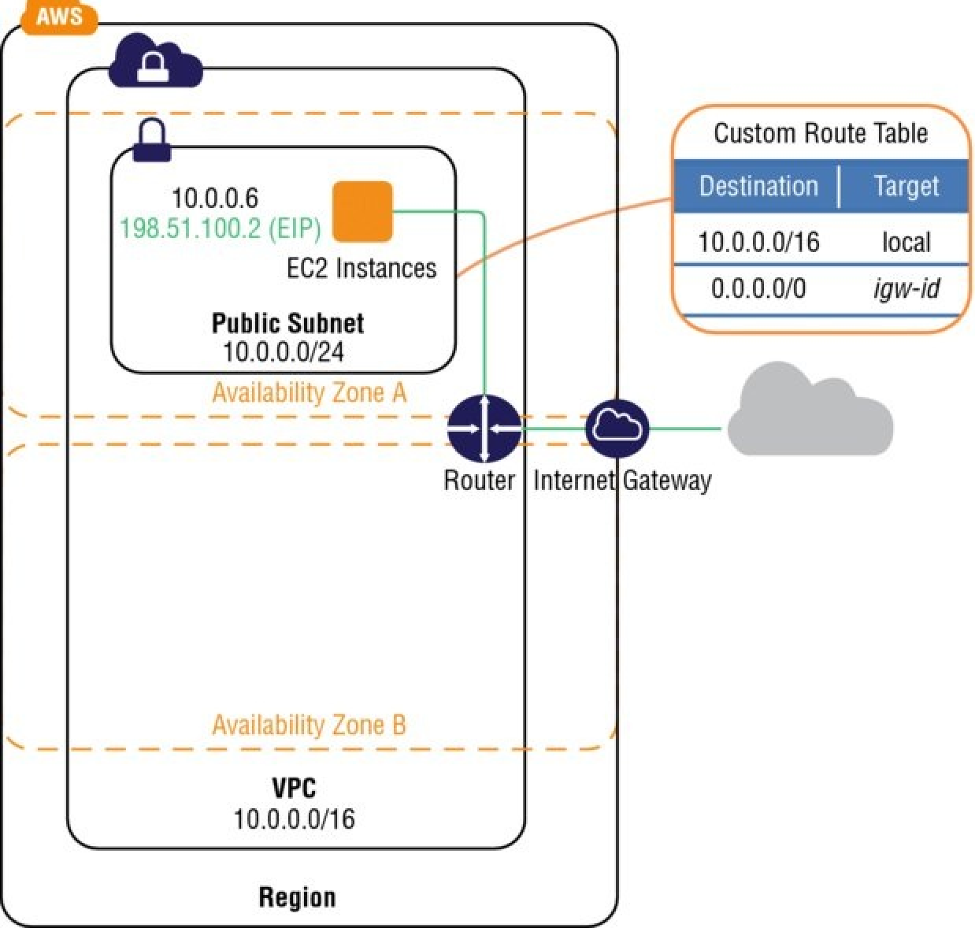
Amazon Virtual Private Cloud (VPC), Optional Components
Internet Gateways (IGWs)

Slide 17

Amazon Virtual Private Cloud (VPC), Optional Components
Elastic IP (EIP) addresses
  You must first allocate an EIP for use within a VPC and then assign it to an instance.
  EIPs are specific to a region (that is, an EIP in one region cannot be assigned to an instance within an Amazon VPC in a different region).
  There is a one-to-one relationship between network interfaces and EIPs.
Elastic IP Addresses

Slide 18
Amazon Virtual Private Cloud (VPC), Optional Components
Elastic IP (EIP) addresses
  You can move EIPs from one instance to another, either in the same Amazon VPC or a different Amazon VPC within the same region.
  EIPs remain associated with your AWS account until you explicitly release them.
  There are charges for EIPs allocated to your account, even when they are not associated with a resource.
Elastic IP Addresses

Slide 19

Amazon Virtual Private Cloud (VPC), Optional Components
Elastic Network Interfaces (ENIs)
Virtual Interface
192.168.1.3
56:8A:C0:DD:EE:FF

Slide 20

Amazon Virtual Private Cloud (VPC), Optional Components
Endpoints
  Specify the Amazon VPC.
  Specify the service. A service is identified by a prefix list of the form com.amazonaws.<region>.<service>.
  Specify the policy.
  Specify the route tables.
Endpoints

Slide 21
Amazon Virtual Private Cloud (VPC), Optional Components
Network Address Translation (NATs) instances and NAT gateways
  NAT Instance
    Create a security group for the NAT with outbound rules that specify the needed Internet resources by port, protocol, and IP address.
    Launch an Amazon Linux NAT AMI as an instance in a public subnet and associate it with the NAT security group.
    Disable the Source/Destination Check attribute of the NAT.
    Configure the route table associated with a private subnet to direct Internet-bound traffic to the NAT instance (for example, i-1a2b3c4d).
    Allocate an EIP and associate it with the NAT instance.

Slide 22

Amazon Virtual Private Cloud (VPC), Optional Components
Network Address Translation (NATs) instances and NAT gateways
  NAT Gateway
    Configure the route table associated with the private subnet to direct Internet-bound traffic to the NAT gateway (for example, nat-1a2b3c4d).
    Allocate an EIP and associate it with the NAT gateway.
NAT Gateway

Slide 23
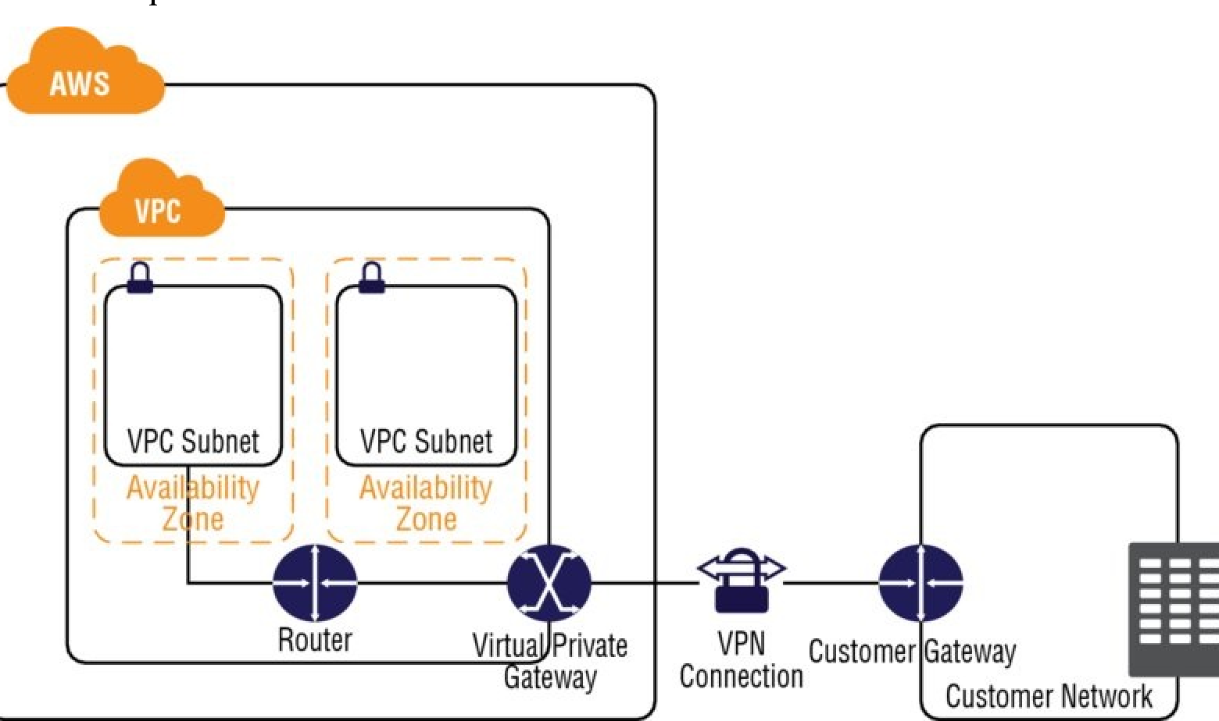
Amazon Virtual Private Cloud (VPC), Optional Components
Virtual Private Gateway (VPG), Customer Gateways (CGWs), and Virtual Private Network
  The VPG is the AWS end of the VPN tunnel.
  The CGW is a hardware or software application on the customer’s side of the VPN tunnel.
  You must initiate the VPN tunnel from the CGW to the VPG.

Slide 24
Amazon Virtual Private Cloud (VPC), Optional Components
Virtual Private Gateway (VPG), Customer Gateways (CGWs), and Virtual Private Network
  VPGs support both dynamic routing with BGP and static routing.
  The VPN connection consists of two tunnels for higher availability to the VPC.

Slide 25
Lesson 3: Network Diagram

Slide 26


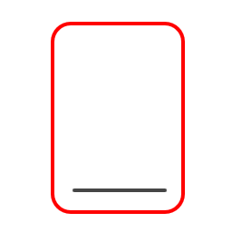


Network Diagram
0.0.0.0/0
Internet Gateway
Internet Gateway
0.0.0.0/0
10.2.0.0/16
10.2.0.0/16
10.1.0.0/16
10.1.0.0/16
Route Table
Route Table
VPC01
0.0.0.0/0
0.0.0.0/0
VPC02
Rules
RDP
ICMP
Rules
RDP
ICMP
10.1.0.0/16
10.2.0.0/16
VPC01-SG01
Security Group
VPC02-SG01
Security Group
VPC01
10.1.0.0/16
VPC02
10.2.0.0/16
0.0.0.0/0
VPC Peering
0.0.0.0/0
10.1.0.0/16
10.2.0.0/16
VPC01-SubNet01
10.1.1.0/24
VPC01-SubNet02
10.1.2.0/24
10.2.0.0/16
10.1.0.0/16
VPC02-SubNet01
10.2.1.0/24
VPC02-SubNet02
10.2.2.0/24
Route Table
Route Table

Slide 27
Lab Module 4

